Slide 1
Seminar on-line: EUSBSR Forum for Gender Equality and Growth 3.0 „Estonian Rural Network and ETNA’s common goal: to inspire women through various cooperation activities“ Ave Bremse – Estonian Rural Network
4. April 2022

Slide 2
Rural Network – tasks
The Rural Network mission is to add value to the implementation of the Estonian Rural Development Programme (RDP)
The membership is unformal but involves bodies representing programme beneficiaries, organizations and authorities engaged in rural development including RDP implementation.
Promoting transnational cooperation, incl. exchanging information with European Network for Rural Development (ENRD);
Providing LEADER support activities for Local Action Groups (LAGs);
Collecting and disseminating project examples;
Promoting the formation of new thematic innovations and new networks.
Publishing weekly e-newsletter; compiling and publishing different publications and information materials;
Organizing and co-organizing information days, seminars, thematic events and conferences;
www.maainfo.ee

Slide 3
Activities:
Publishing e-newsletters;
Exhibitions, competitions, publications, databases
Cooperation with umbrella organizations: Local food networks, Village movement „Kodukant“, Estonian Rural Tourism, agricultural organizations, young farmers, innovation clusters, etc.
Participation in European Rural Network activities and projects
Partner Search (LEADER)
Open Farm Day
Smart villages
Rural women's theme - co-operation with ETNA Estonia!

Slide 4
Cooperation with ETNA Estonia

Slide 5
Annual conferences in Jäneda 2017-2021
10.12.2017 - "Hello! Let's do business!" Topics: In the changing times of entrepreneurship, information centers for women's entrepreneurship - NETs, microcredit, community support, cooperation opportunities - Latvia, Lithuania, Moldova, invention
22.03.2019 - "Footprints of the Future" Topics: ETNA activities, microcredit, women and ingenuity, soft landing, back in Estonia, Smart Villages - Choosing an Entrepreneurial Woman!
16.10.2020 – Community Footprints - Topics: Research Presentations, Community and Umbrella, Renewable Energy and Organic Production, Environmental Art Projects, Day Cafes, Discussions
19.10.2021 – "Inspirational footprints" - Topics: ETNA activities, EVEA about entrepreneurship, inspiring entrepreneurial women, Opportunity to work with ADAPTER, public health, youth projects, discussions

Slide 6
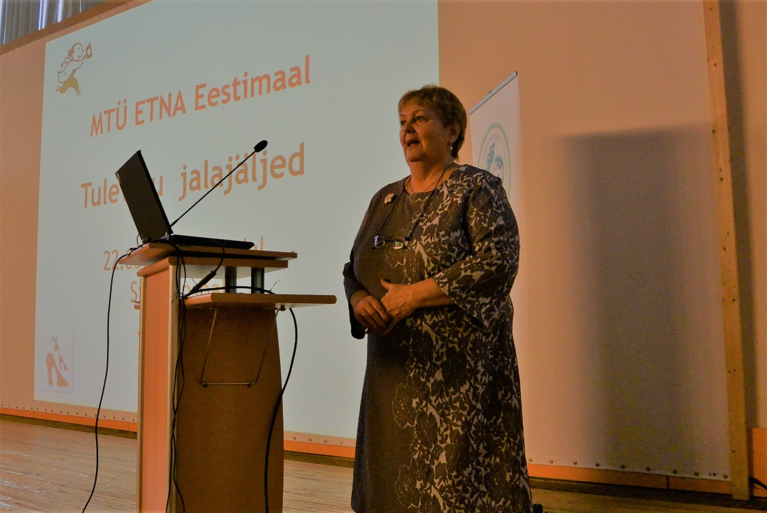
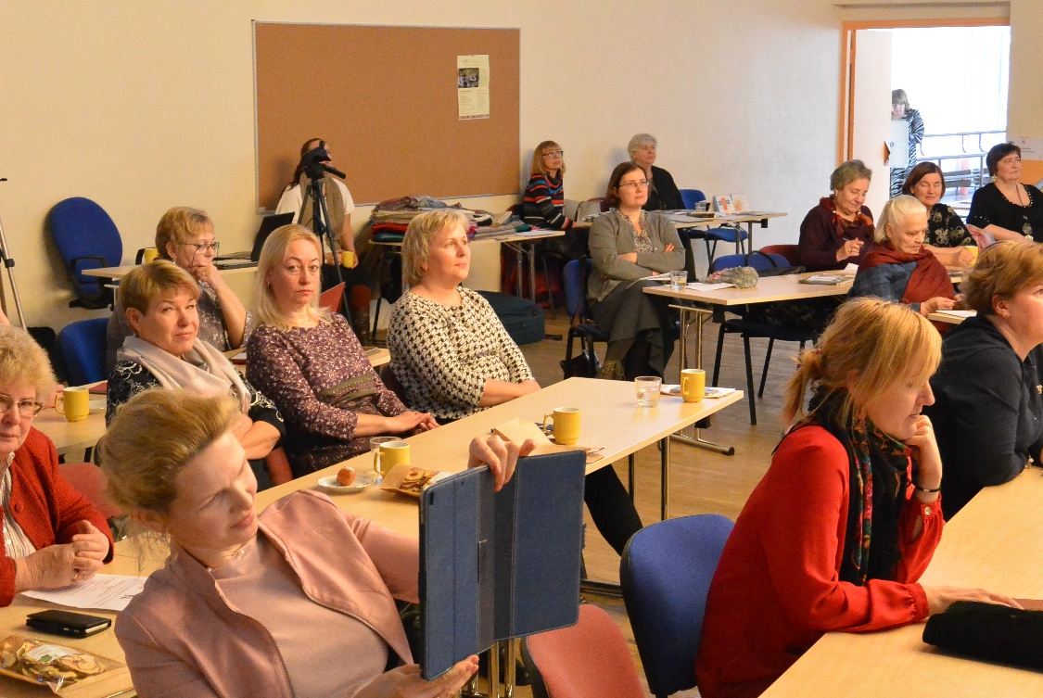
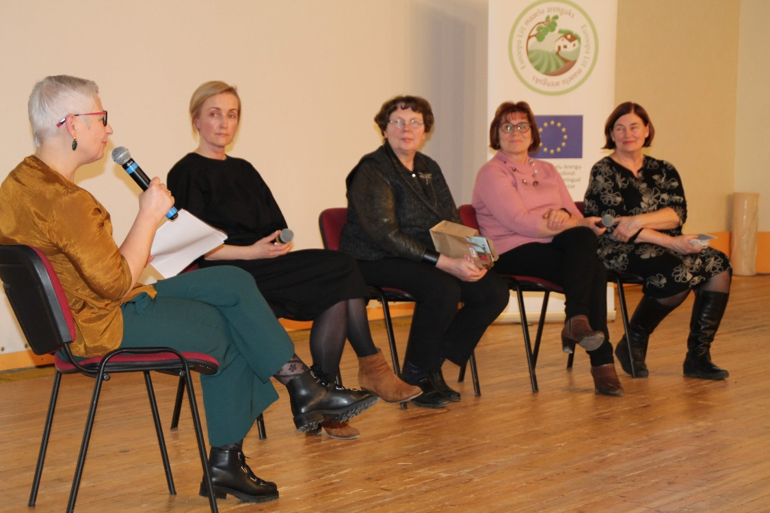
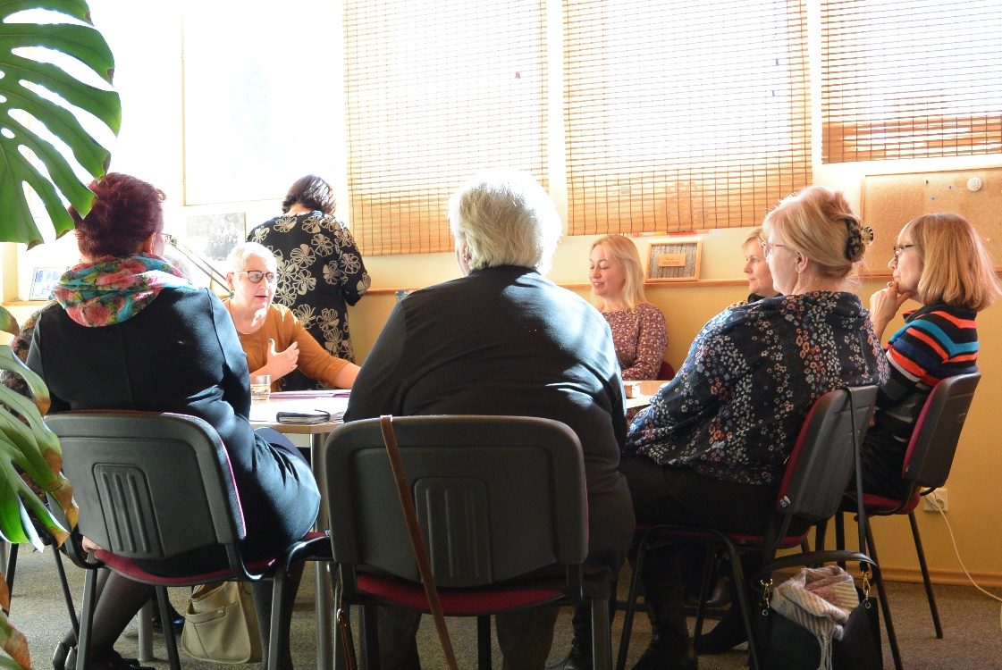

Slide 7
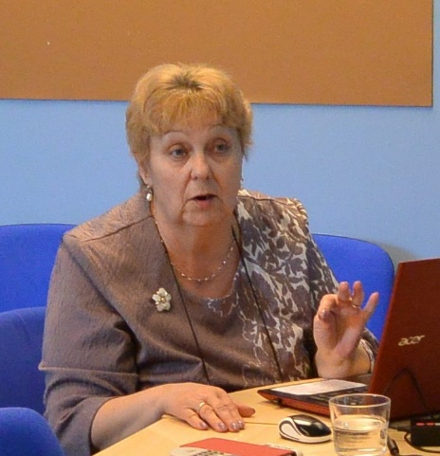
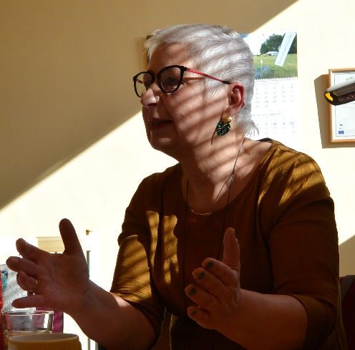
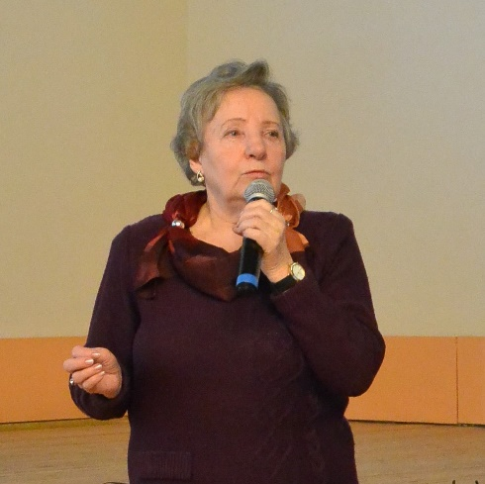
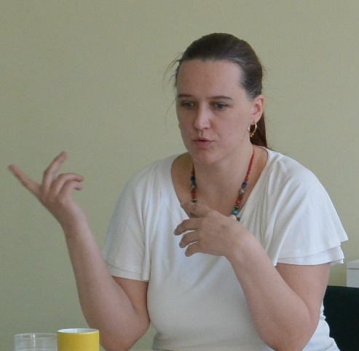
Webinars
Back in Estonia - and become an entrepreneur in rural areas ?, 12.06.2019 - Minni Riar - back from India
2. Women and ingenuity, 22.08.2019 - Anne-Mari Rannamäe - QUIN Estonia (innovative women) and Viive Rosenberg
3. ETNA microcredit, 27.09.2019 - Margo Orupõld and Greta Pukk

Slide 8
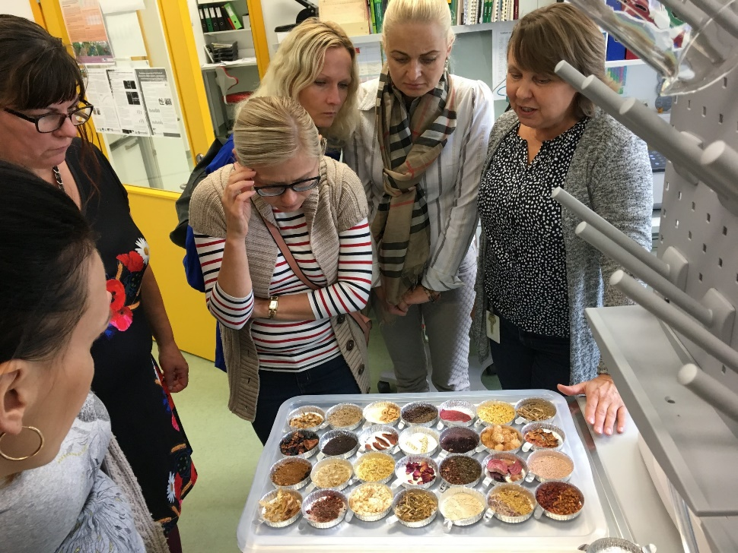
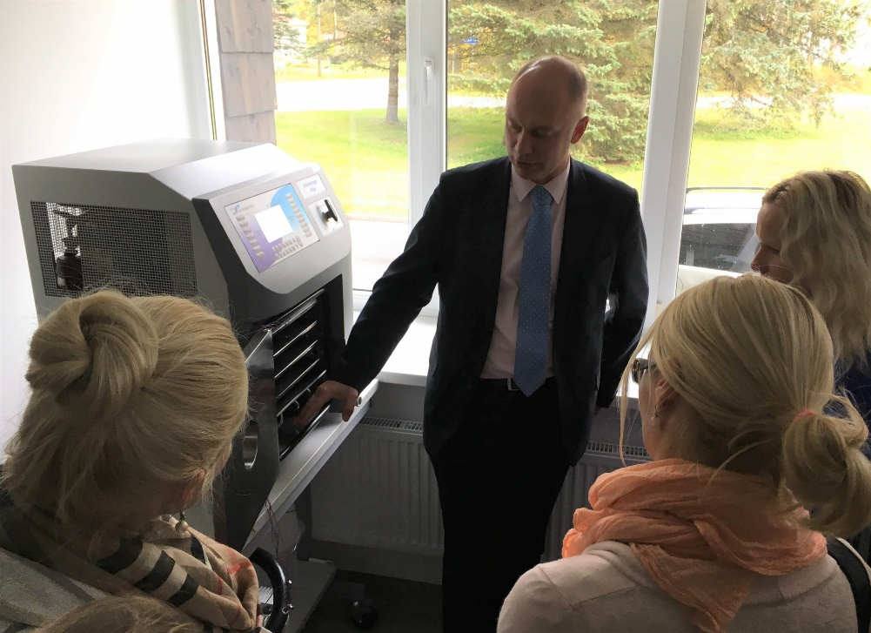
Study vist to Polli 3.10.2019
Visit to Estonian University of Life Sciences Institute of Agricultural and Environmental Sciences Polli Horticultural Research Centre - getting acquainted with the possibilities of developing health and natural products www.maainfo.ee/index.php
Participants: 42 – Positive feedback from both sides

Slide 9
Round table "Women in the Country - Expectations and Solutions" - Tallinn 7.11.2019
Are the opportunities equal? - Liisa Pakosta, Commissioner for Gender Equality and Equal Treatment
For women focused on social activities - KODAR, Overview of NGOs Kersti Ringmets, Civil Society Adviser at the Ministry of the Interior
Non-agricultural entrepreneurship in the countryside - Sirje Vällmann, ETNA in Estonia
Agricultural business in the countryside - Kerli Ats, Farmers' Union
DISCUSSIONS - How to support women's entrepreneurship in rural areas?
Participants 30

Slide 10
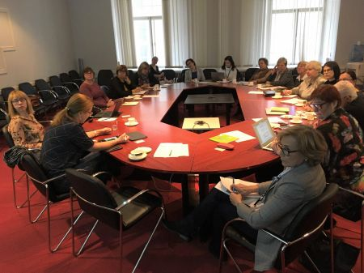
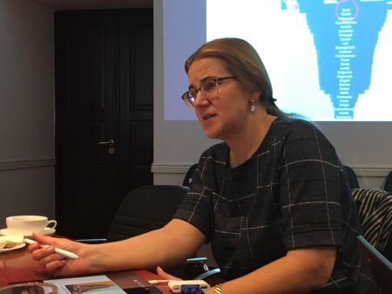
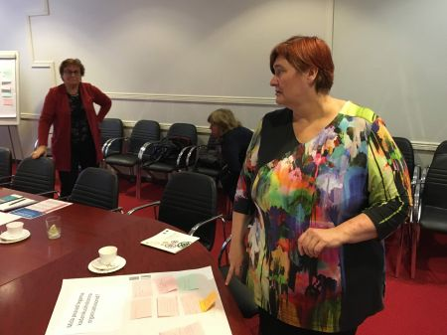
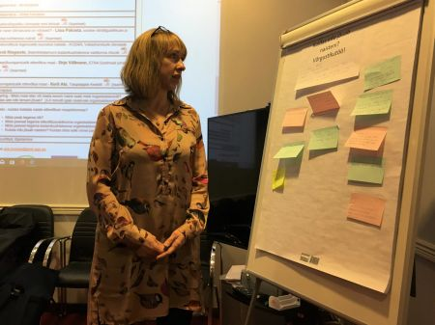

Slide 11
Support to Ukraine
Estonian Rural Network started: Rural Forum in support of Ukraine – A platform to share experiences between diferent rural organisations and municipalities.
ETNA Estonia has participated and propoused microcredit programm also for Ukraine war refugees.

Slide 12
Project application: FLORA
Project application: Horizon -CL6-2022-COMMUNITIES - FLORA Fostering women-Led sustainable and cultural innovation in farming and Rural Areas
9 countries application -
Cooperation partners: ETNA in Estonia, Estonian Rural Tourism , etc Activities: Studies, methodological materials, pilots in different countries and topics Planned activities of the Estonian pilot: non-agricultural entrepreneurship in the field of rural tourism, sustainable tourism and innovation. Mentoring program. Digital solutions and use of local events: open farm day, cafe day, etc.

Slide 13
FLORA’s CONSORTIUM – juhib ANYSOLUTION (ESP)
# | PARTNER | TYPE | COUNTRY
1 | ANYSOLUTION | SME | Spain
2 | UNINOVA | RTD | Portugal
3 | SFCOLAB | RTD | Portugal
4 | F4S | RTD | Portugal
5 | CNR | RTD | Italy
6 | FRAUNHOFER | RTD | Germany
7 | LTFE | RTD | Slovenia
8 | ARC | Public | Estonia
9 | ERNACT |  | Ireland

Slide 14
Tegevused
Gender equality workshop | Soolise võrdõiguslikkuse töötoad! Soolise võrdõiguslikkuse kava jm. Arutada - kas sama või erinev sisu!
Innovation, circular economy and alternative energies workshops | Naisettevõtjate fookusgrupp (laiendatud) maaturismi valdkonnas jätkusuutlike lahenduste tutvustamine
Sustainable tourism innovation workshop | Jätkusuutlik turism - loodusturism jm põhimõtted
Digital workshop | Digiturundus meetmete tutvustus: veebileht, e-teenuseed, SOME, platvormid, jne
Enterpreneurship training | Ettevõtlus koolitus
Menoring programme local study tour | Õppereis - Eestis - Avatud talude päved, jt kohalikud üritused - kuidas kohaturunduses kasutada
Innovation ecosystem workshop | Innovatsiooni võrguslikud (Adapter)
Ecosystem mentoring programme | Mentorlusprogramm - 10 naist maaturismist fookusrühmana + teised
Estonian Pilot Final Conference | FLORA tulemusi tutvustav konverents lõpus
Material / Equipment for co-working space | Kuni 3 naisettevõtluse keskuse käivitamine
International study visit costs | Rahvusvaheline õppereis - maaturismi jn naisettevõtluse teemal
Dissimination and and communication events | FLORA projekti teema tutvustused

