Slide 1
PAIK-NET
PAIK Women Resource Center
Kertu Langinen
04.04.2022

Slide 2
Kertu Langinen – entrepreneur in rural area
Born in rural area in Estonia
Lived abroad
Came back with my family to live in my birthplace
Didn´t want to go to work far away – only option to find something that I could do at home.
Educated myself and found support from diferent groups (PAIK-NET)

Slide 3
PAIK-NET main activities
Information center was established in 08.03.2011
Operates in Tamsalu with PAIK LEADER local action group.
Cooperation and mentoring NGO ETNA Estonia
PAIK-NET is for local women and their networks to practice entrepreneurship in the area.
Trainings, study days, study trips
ETNA Microcredit programme

Slide 4
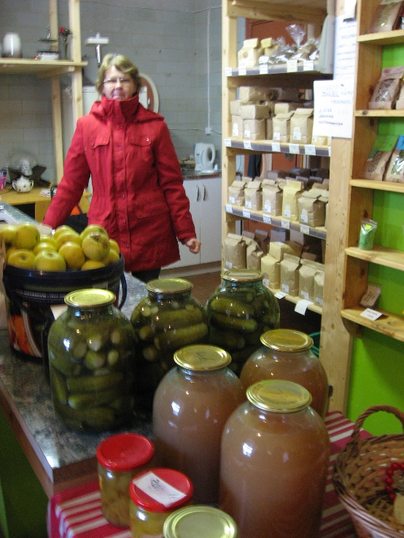
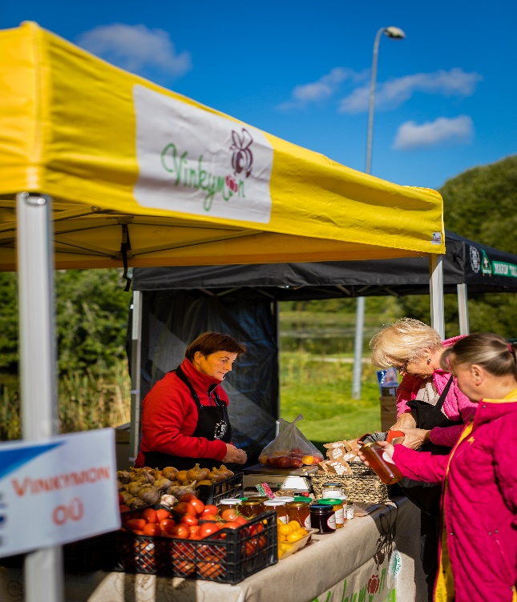
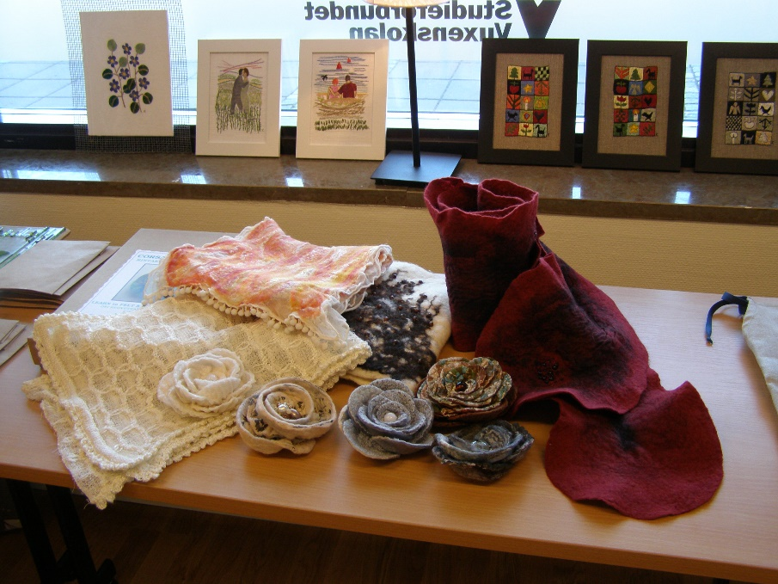
Measures: Local meetings in PAIK-NET
Introduction of support options (LEADER and other support schemes)
To collect information about women in te area
Joint marketing of products - fairs, food networks

Slide 5
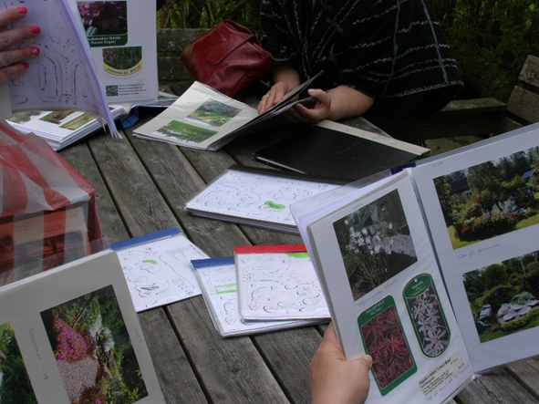
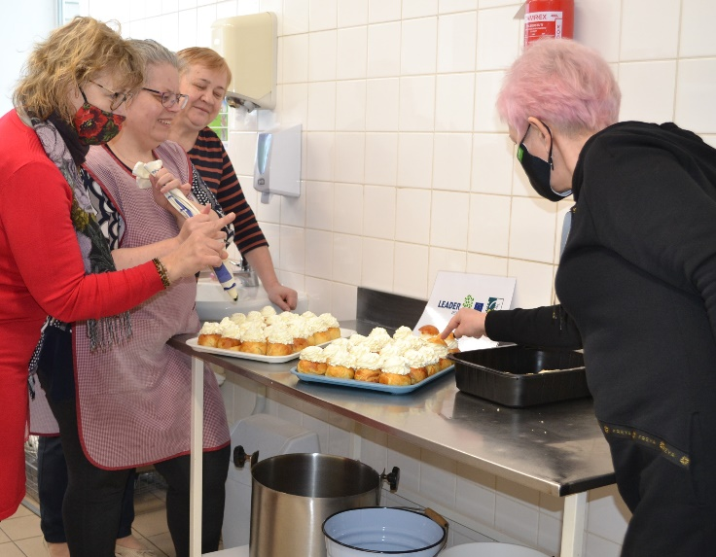
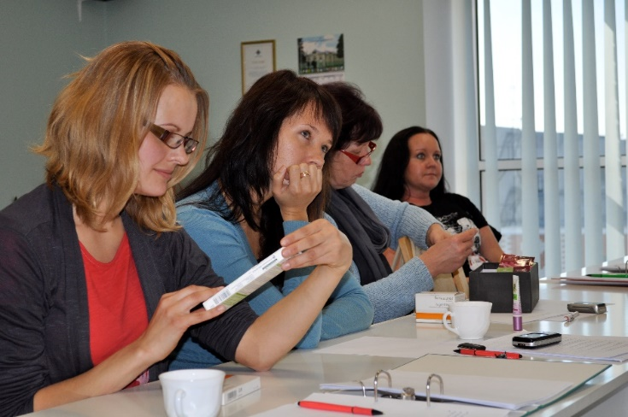
Measures: Organizing trainings, information days
Entrepreneurship training (starting a business, support opportunities)
Local food trainings, picnics, etc.

Slide 6
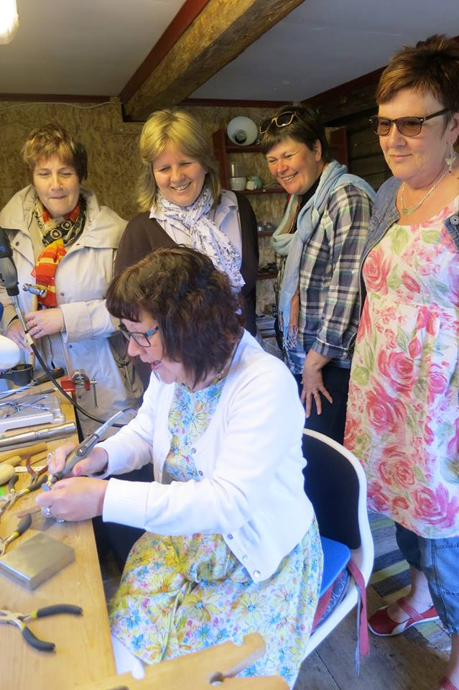
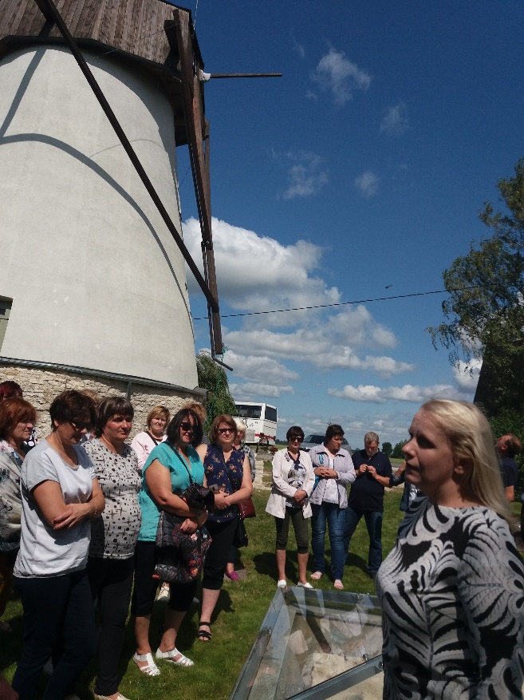
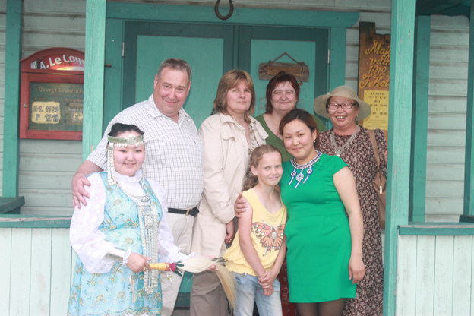
Measure: Study trips and cooperation
Cooperation with ETNA network
Study trips in Estonia, Latvia, Finland, Sweden, Moldova and Georgia

Slide 7
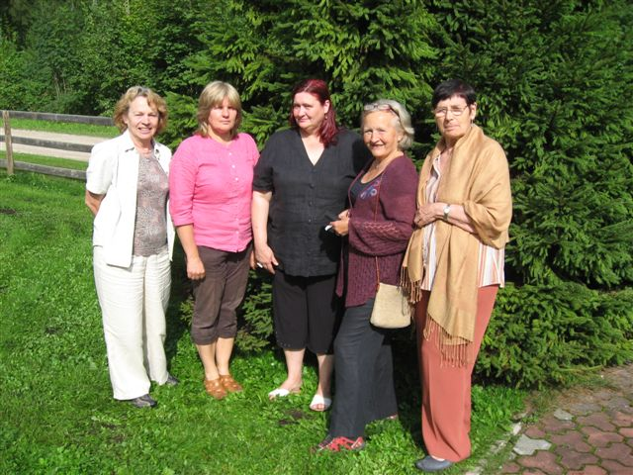
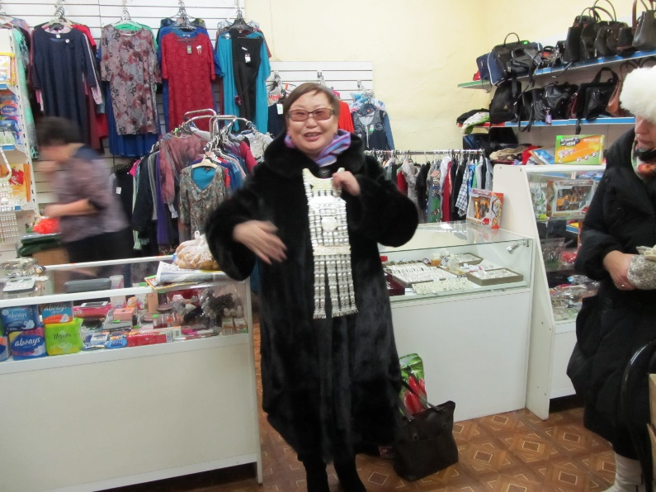
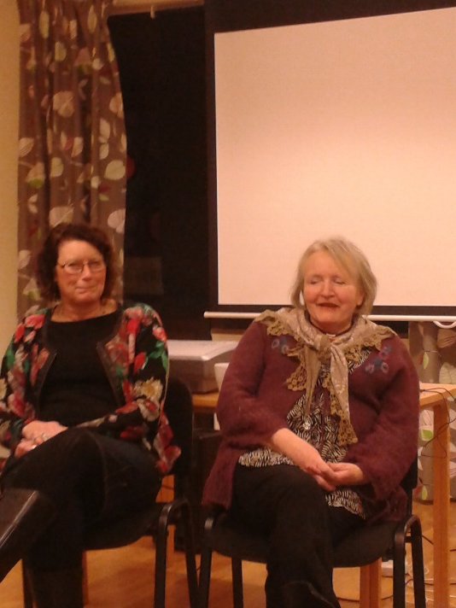
Examples:
Cooperation project with Swedesh and Latvian information centers for women – project „Cultural heritage of Women and Entrepreneurship“
Development of cooperation and networking, acquaintance with other information centers and programs for women entrepreneurs, joint discussion groups

Slide 8
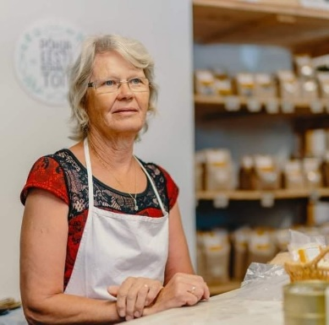
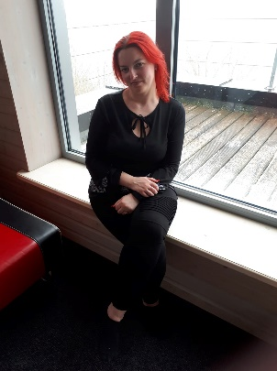
Measure: ETNA Microcredit programme
Our Pandivere group has been along from the beginning
6 members in 2022
Loan for group members – to build greenhouse, renovation of production facilities, purchase of beekeeping equipment, purchase of felting machine, purchase of an apple juice press
Joint events – trainings, study trips, Entertainment events

Slide 9
Thank You!

