Slide 1
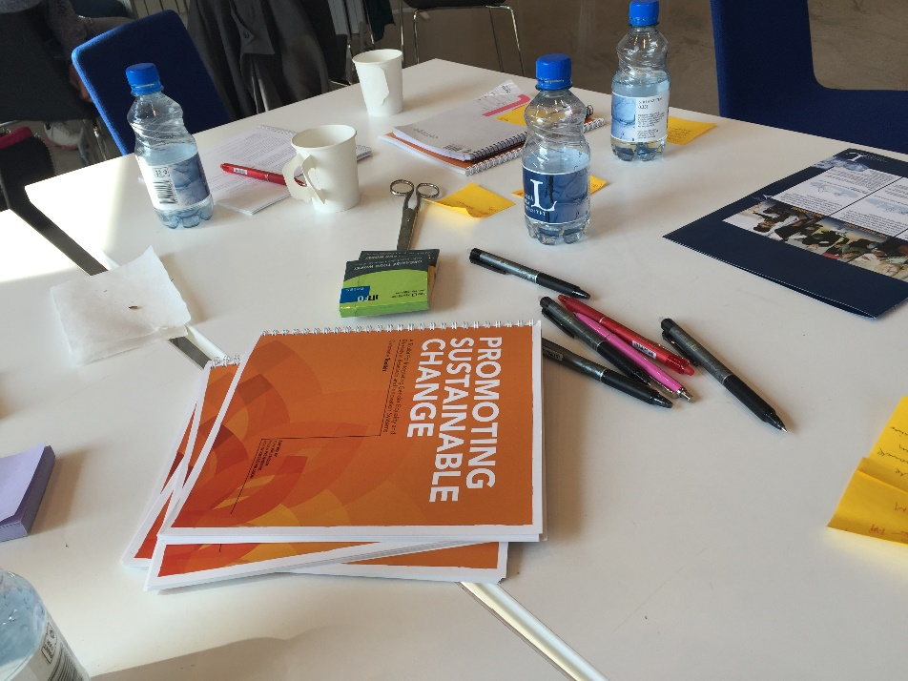
Promoting Sustainable Change Toolkit for Integrating Gender Equality and Diversity in Research and Innovation Systems
Paula Wennberg, Gender Contact Point
EUSBSR Forum (Zoom)
March 31, 2021
https://genovate.cdt.ltu.se/

Slide 2
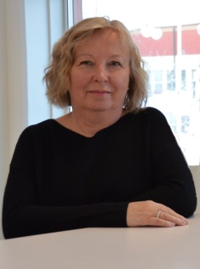
Who am I
Paula Wennberg
paula.wennberg@gmail.com
Founder of Gender Contact Point
Member of Winnet Centre of Excellence
Founder of the Gender Contact Point platform that supports gender mainstreaming processes in academia, industry and surrounding society. She has a long background of managing projects in gender equality, inclusive growth and innovation in Sweden and internationally, with a particular focus on innovation in ICT industry.

Slide 3
Gender Contact Point
https://www.ltu.se/centres/cdt/Gender-Contact-Point
Door to gender research and research with a gender perspective at Luleå University of Technology
Supports gender mainstreaming processes of academia, industry and public sector
Offers collaboration, knowledge development and knowledge sharing
Universities, companies, public authorities, NGOs, other actors and organisations in Sweden and internationally
Researchers from diverse disciplines, faculties and departments
University academic management and support systems (Human Resource, Grants Office, Innovation Office, Procurement Office, LTU Business etc)
Tailored tools and methods
Annual Gender Contac Point Day
Brings together researchers, companies, policymakers, funding bodies etc
Knowledge sharing, networking
Makes the research results available and easier to access to audiences beyond our own community
Assets
Gender research and gender-mainstreaming expertise
Methods, tools, handbooks
Network of researchers
Partner network

Slide 4
Gender mainstreaming in practice
Goals
Gender equality
Create value
Generate gender-awareness
Strategy
Gender mainstreaming
Process
Monitoring
Increase knowledge
Tools and methods
Follow-up

Slide 5
Integration of gender and gender equality
Gender-balanced project teams
Gender-balance in management structures
Gender dimension in the content of project, research and innovation
Decision-making
Recruitment
User participation
Communication
Dissemination
Sustainability

Slide 7
Why inclusive innovation, entrepreneurship and growth?
Innovation
Narrow focus on innovations
Narrow innovation focus
Major disadvantages
Missed opportunities to better serve consumers and grow businesses
Value for citizens, consumers, users
Entrepreneurship
Important for job creation and economic growth
Inclusive entrepreneurship
Contributes to social inclusion and gives people with different backgrounds an equal opportunity to start up and operate businesses
Women, men, youth, migrants, unemployed people
Smart, sustainable and inclusive growth
Balance between economic and sustainable development
To boost job creation, growth and competitiveness

Slide 8
Benefits of gender equality
Added value in terms of excellence, creativity, and business opportunities
Boosts creativity and innovation
Helps to question gender norms and stereotypes
In-depth understanding of needs, behaviours and attitudes of stakeholders
Products and services will be more relevant
A competitive edge for industry
Enhanced market potential
Creates effective and sustainable organisations
Essential to the further development of the IT sector
Both women and men should participate in the development of the future IT
Enhances excellence in research and innovation
Broadens the labor market for both men and women
Contributes to an attractive region
Contributes to sustainable growth

Slide 9
Resistance
Can be active, passive, individual, structured
Lack of knowledge
Do we need this?
Why?
How?
We have already done this.
Time issue
People do not show up at meetings/events
Competing interests
”Too much attention on gender equality will lead to a wrong image of our core business/activities.”
Power holders
Who sets the agenda?
Who is talking at meetings?
Who writes the minutes of a meeting?
Follow-up
No systematic follow-up of the equality actions, progress, outcome

Slide 10
Toolkit for Integrating Gender Equality and Diversity in Research and Innovation Systems
The toolkit can help your organisation or project better connect with a diversity of stakeholders, both internal and external. Transfer their experiences, attitudes, ideas and thoughts into actionable ideas. This toolkit can assist you in promoting sustainable change https://genovate.cdt.ltu.se/

Slide 11
Are you a facilitator?
A process leader?
A university staff member?
Part of an innovation system?
An experienced or a new innovator?
An educator?

Slide 12
The toolkit encourages people to learn more about gender equality and diversity.
The toolkit is aimed to be generic enough for different areas and interests.
The toolkit provides a process of how to involve people in gender equality and diversity matters.
The toolkit is easy to use, flexible.
The toolkit can complement other approaches, be innovative in choosing and mixing your methods and collaborators.
The toolkit does not offer solutions and it does not ensure success. It offers techniques, methods, tools, tips and examples that can guide you through the process.
This toolkit is based on interactive and participatory methods and processes to promote innovation and sustainable change through reflection.
Remember that the process is there to guide your way, the methods to facilitate the project and the participants to make the change.

Slide 13
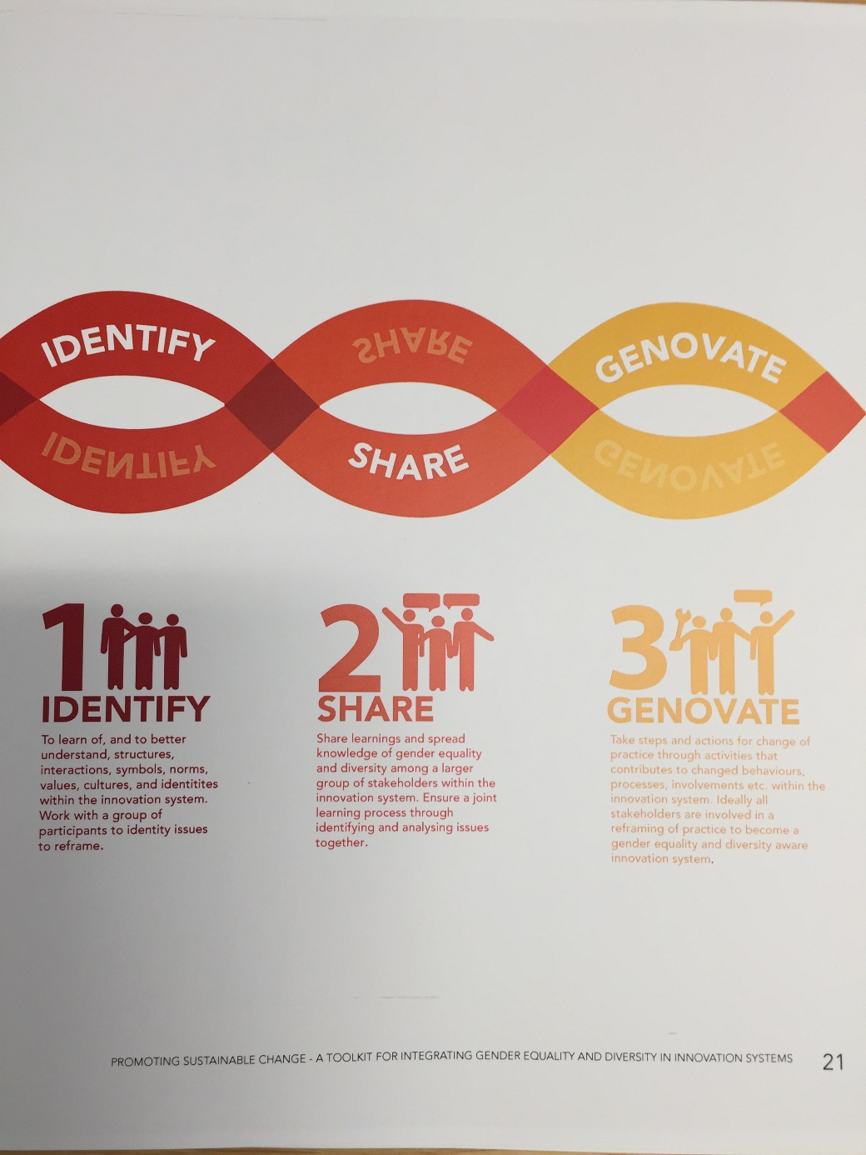

Slide 14
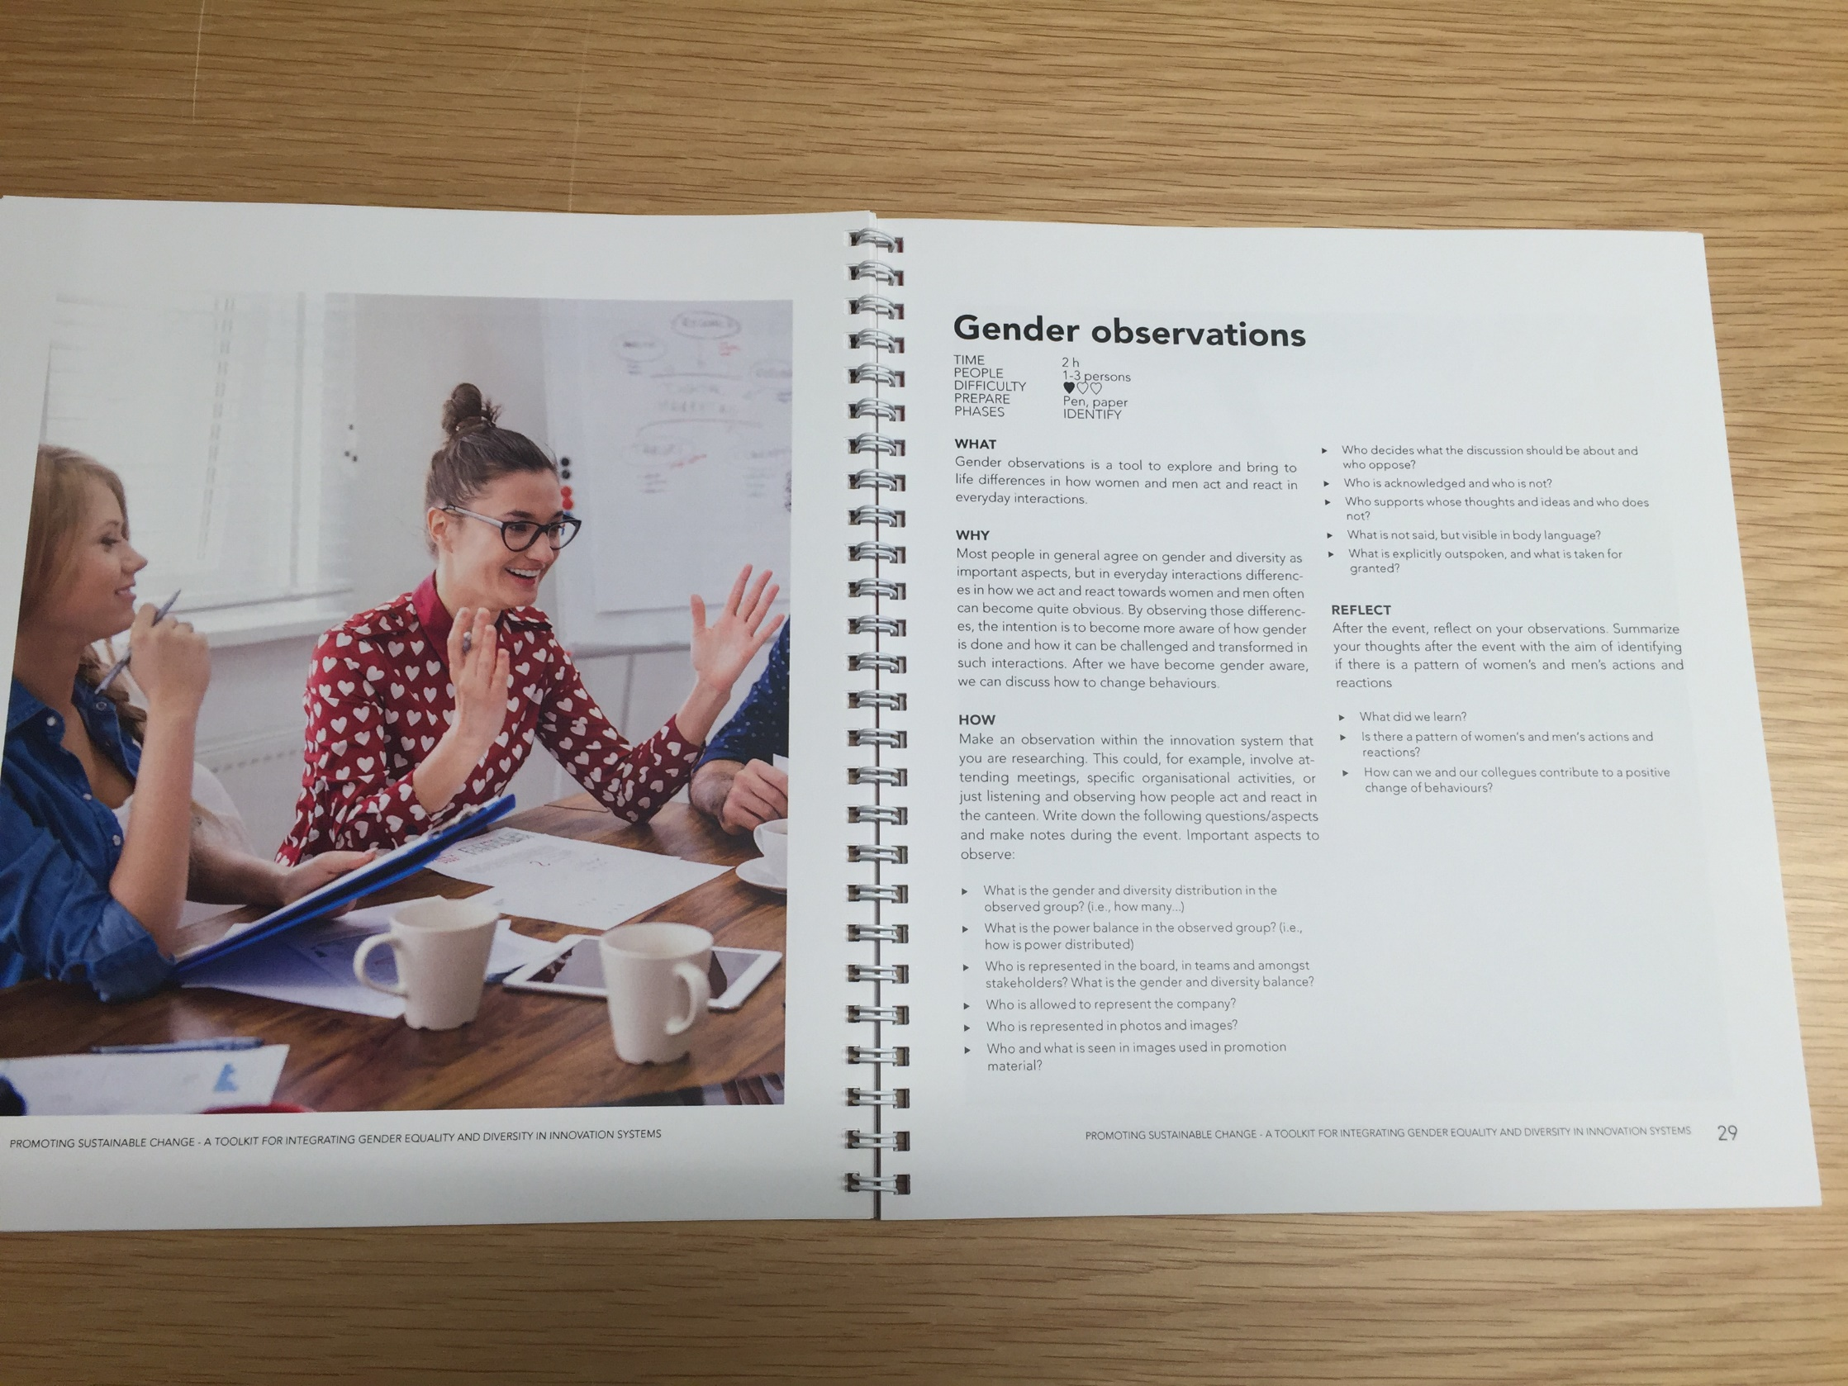

Slide 15
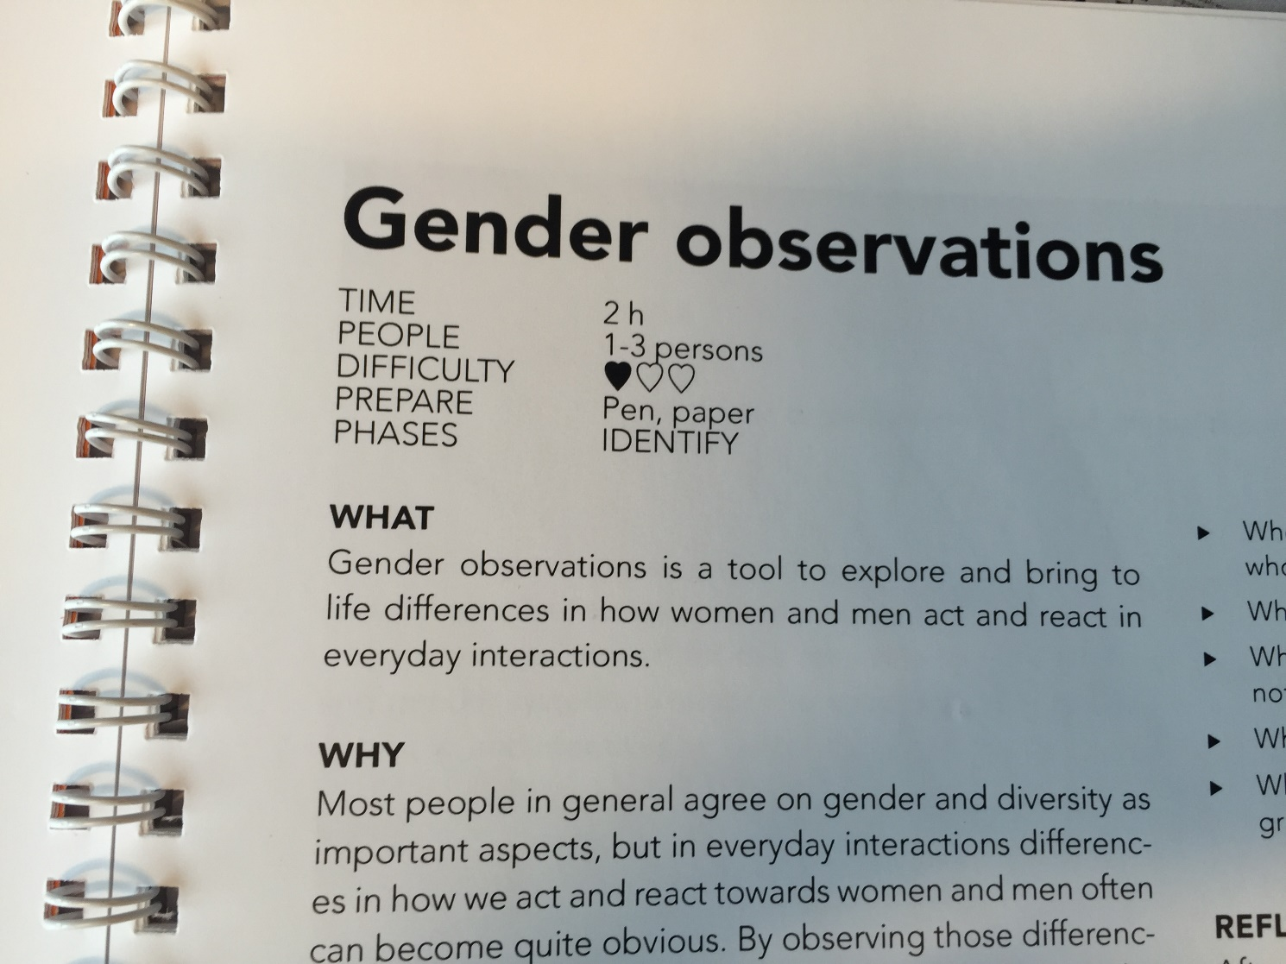

Slide 16
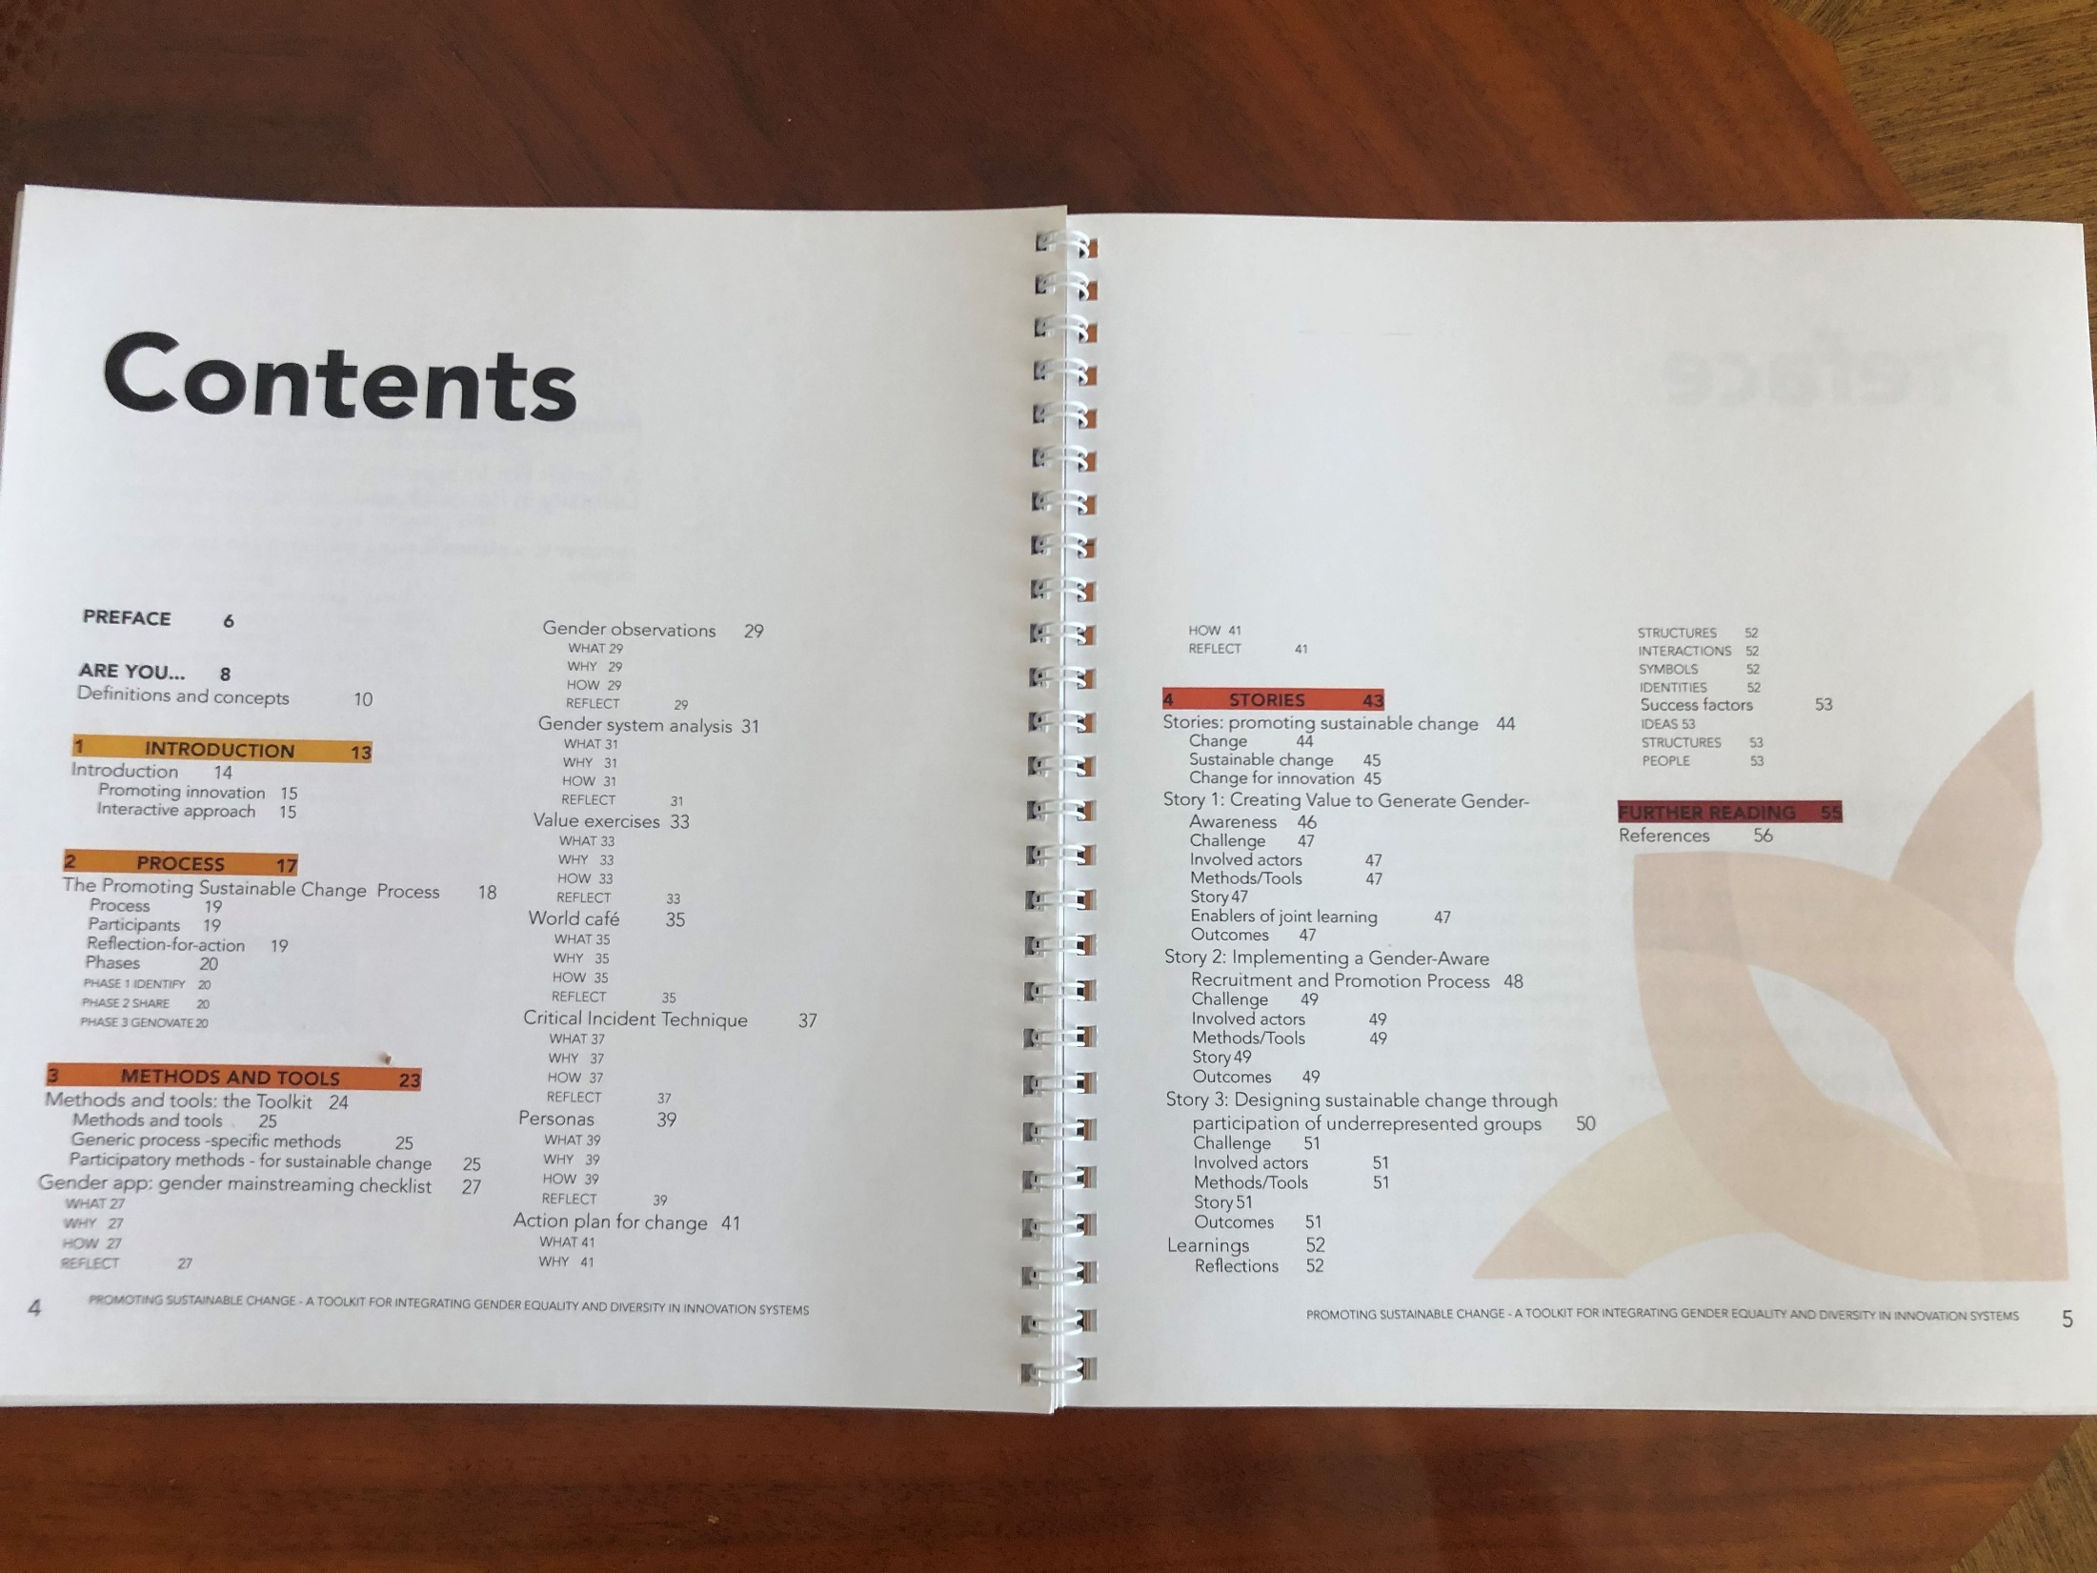

Slide 17
Interactive workshop
Introduction to gender equality and gender mainstreaming
Homework assignment
Tool: Gender Observations
Interactive workshop
Tool: Persona
Tool: Critical Incident Technique
Tool: Action Plan
WHAT are the challenges?
WHAT do we want to achieve?
How – concrete actions to achieve the goals
Presentation of the group work results
Sharing ideas, knowledge, experiences, plans
Reflections
Homework assignments
Next step
Follow up

Slide 18
Gender observations
Make an observation within the innovation system that you are studying
Office
Meetings
Other activities
Or just listening and observing how people act and react at lunch, coffee break
Write down the questions/aspects and make notes
Important aspects to observe, see instructions

Slide 19
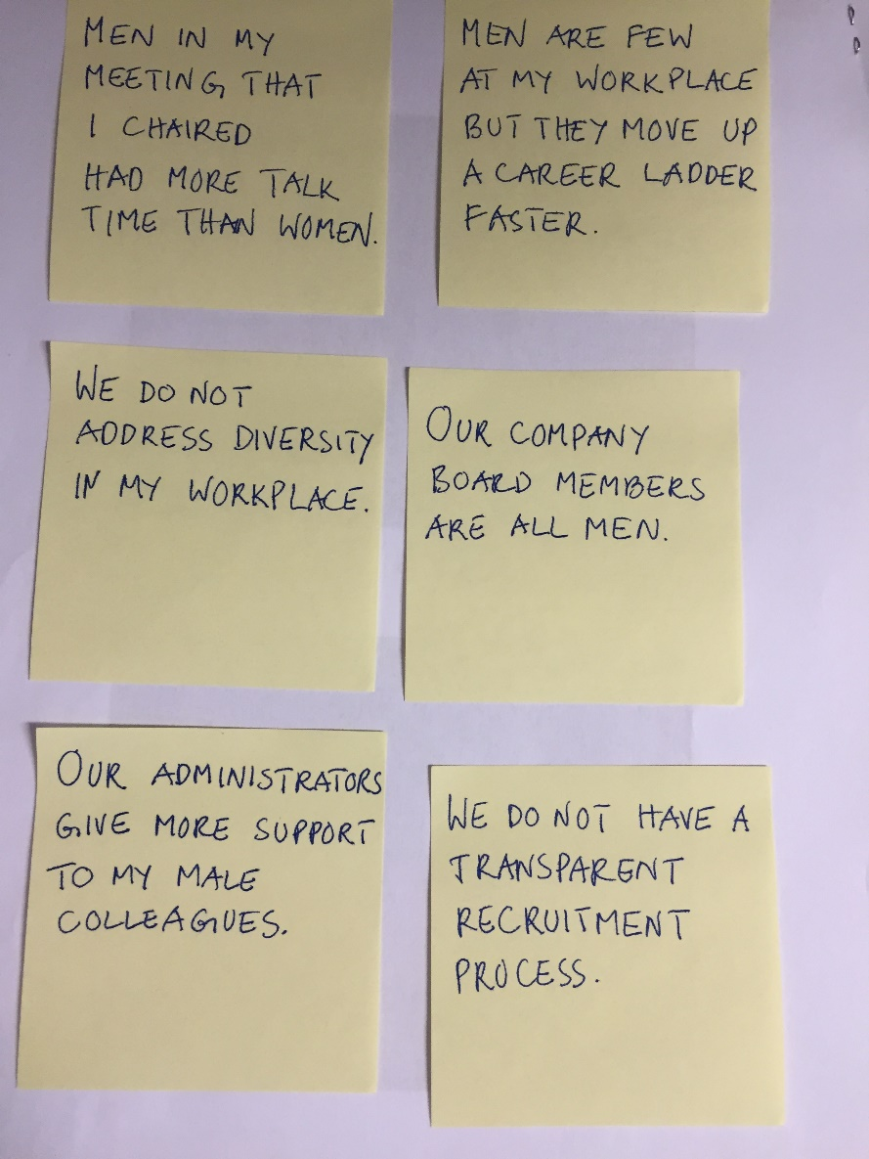
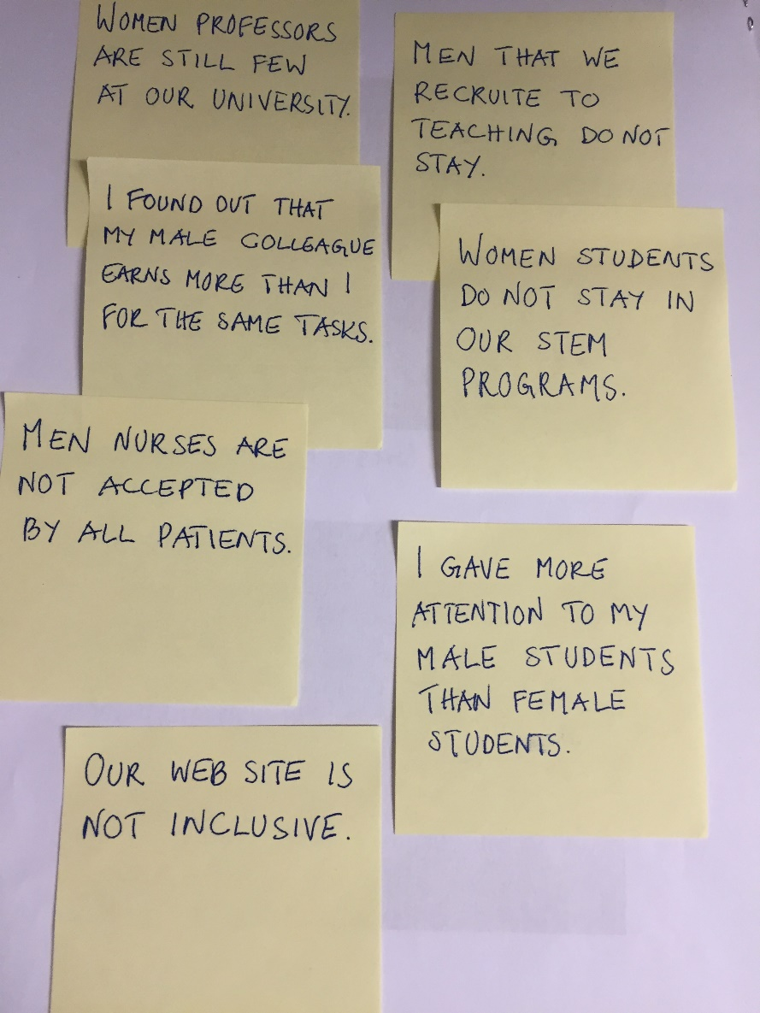
Critical Incident Technique - Examples

Slide 20
Homework assignment
Homework ”Action plan”
Create an action plan related to your service/product development or related to gender equality work (entrepreneurs)
Your plan to overcome the challenges with concrete actions

Slide 21
Follow-up session
Entrepreneurs
How to take my business to the next level?
Homework to be presented: 1-2 concrete actions (in the short term).
How can my business plan be improved through gender equality?
Homework to be presented: 1-2 examples

Slide 22
Quadruple Helix
Academia, industry, public organisations, civil society
Government, industry, academia and civil participants work together to co-create the future and drive structural changes far beyond the scope of what any one organization or person could do alone.
(European Commission, Digital Agenda for Europe, Open Innovation)

Slide 23
Thank you!

